Slide 1
Semantic Limits of Dense Combinatorial Objects
Alexander Razborov
University of Chicago
Steklov Mathematical Institute
joint work with Leonardo Coregliano
“Randomness, Information and Complexity”, Moscow, June 13, 2019
Notes:
Continuous Combinatorics – emerging area.

Slide 2
Graphons
[Lovász B.Szegedy 06]
Weighted measurable ``graph’’ on Ω
x
y
Ω=[0,1]
Cryptomorphic to its set of ``moments’’ φ_{W}

Slide 3
H is a fixed template, G a large graph. t_{hom}(H, G) –
homomorphism density:
Variants (always densities):
Injective homomorphisms t_{inj}(H, G), almost the
same since G is large;
Induced embeddings t_{ind}(H, G);
Induced copies p(H, G).

Slide 4
Conversion formulas

Slide 5
Compactness is fundamental but very easy to
prove. As a consequence, there are many
convergent sequences.

Slide 6
Easy direction: graphons ➔ convergent sequences: sampling.
Hard direction: convergent sequences ➔ graphons.
The original proof in [Lovász B.Szegedy 06] used
Szemeredi’s Regularity Lemma.
Notes:
Mention hypergraphs etc.

Slide 7
Uniqueness
[Borgs Chayes Lovász 08]
Theorem. Every graphon W is uniquely determined
by φ_{W} up to a measure-preserving isomorphism.
W₁
W₂
W
Notes:
Very geometric theory.

Slide 8
Flag algebras (graphs only)
[R 07]
Flag algebras in a nutshell: by-passing all geometry
(that is the middle term above).
Why???

Slide 9
Concrete computations with applications in extremal combinatorics, semi-definite programming.
Uniform treatment of more complicated objects.
Graphon extensions for which the geometric theory (-ons) is available (from Lovász’s book and beyond): hypergraphons, digraphons (and tournamons), edge-colored graphons, permutons, posetons, limits of interval graphs, limits of sets in linear spaces… you name it.

Slide 10
Our work
An attempt at developing a language to reconcile both ``worlds’’, geometric and algebraic. Earlier attempts: [Austin 08; Aroskar Cummings 14].
Graph Limits
Flag Algebras
Exchangeable Arrays [Aldous 85; Kallenberg 05; Austin 08]
Quasi-Randomness [Thomason 87; Chung Graham Wilson 89; Chung Graham 91]
Hypergraphons [Elek Szegedy 12]
Digraphons [Diaconis Janson 08]
Permutons [Hoppen Kohayakawa Moreira Rath Sampaio 13]
Removal Lemmas [Austin Tao 10; Petrov 13].

Slide 11
Bits of Logic
(identical to flag algebras)

Slide 12
Examples: graphs, bi-partite graphs (with explicit
partition or without), hypergraphs, digraphs, tournaments, multi-graphs, edge or vertex colored graphs, orders, partial orders, equivalence relations.
Examples: extremal combinatorics. All of the above plus forbidden configurations, induced or not.
Examples: mix and match (and maybe add additional axioms). Cntd. on the next slide.

Slide 14
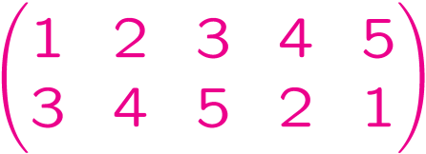
3
2
1
4
5
Cryptomorphic to permutons [Hoppen Kohayakawa
Moreira Sampaio 13] (details time permitting).

Slide 15
(Open) Interpretations
(very briefly)

Slide 16
Non-edge
Edge

Slide 17
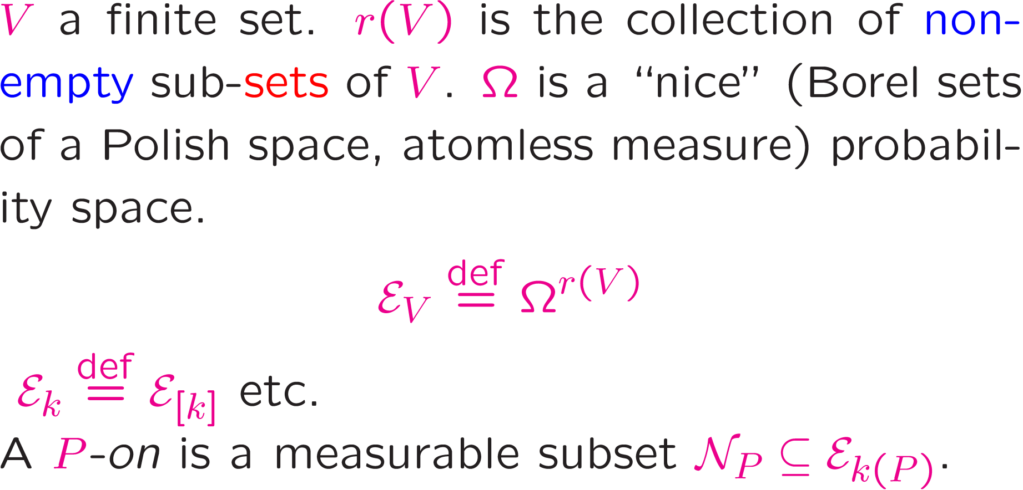
Step I. P-ons (Peons)

Slide 18
No symmetries assumed!

Slide 19
Step II. Euclidean structures

Slide 20
Step III. T-ons (Theons)

Slide 21
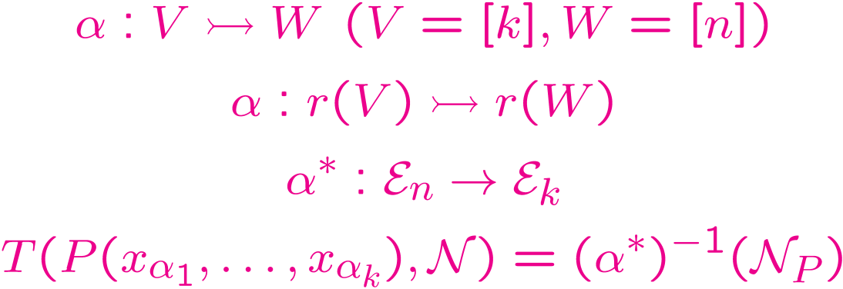
Moving information around

Slide 23
Step IV. Existence and uniqueness
How do you prove the existence of various -ons in general? Three schools of thought.
Szemeredi’s regularity lemma [Lovász Szegedy 06]
Ultraproducts [Elek Szegedy 06]
Exchangeable arrays [Diaconis Janson 08]

Slide 24
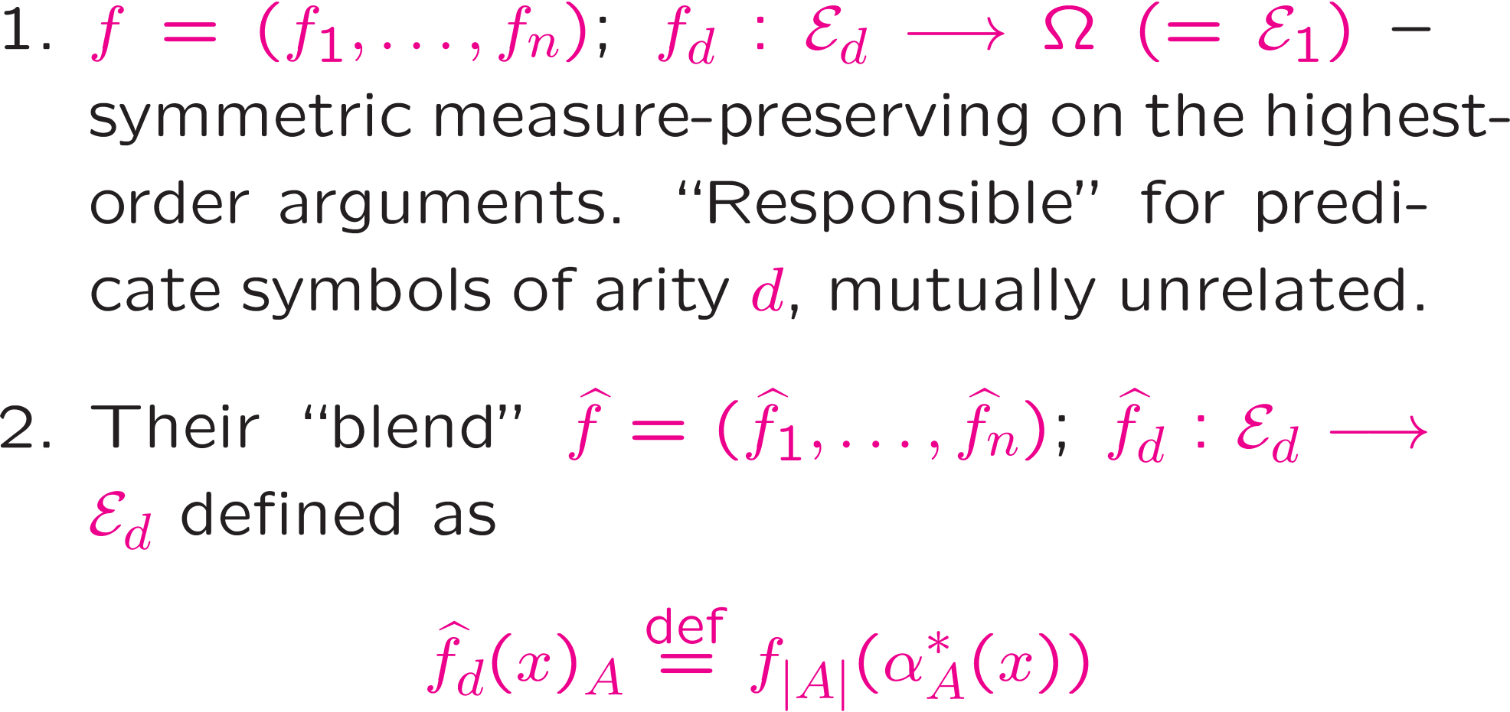
Uniqueness turns out to be more subtle than in [Elek Szegedy 06] since we have to combine predicates of different arities. Two-stepped approach.

Slide 25
Further topics, I.
Euclidean removal lemmas

Slide 26
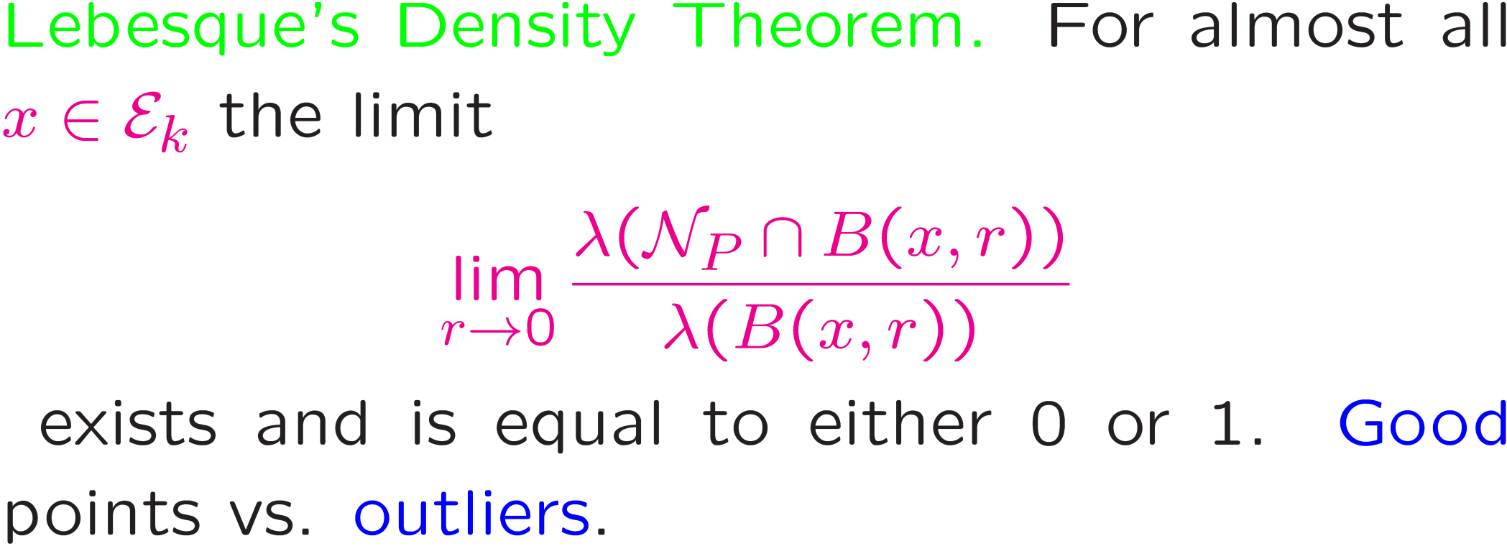

Slide 28
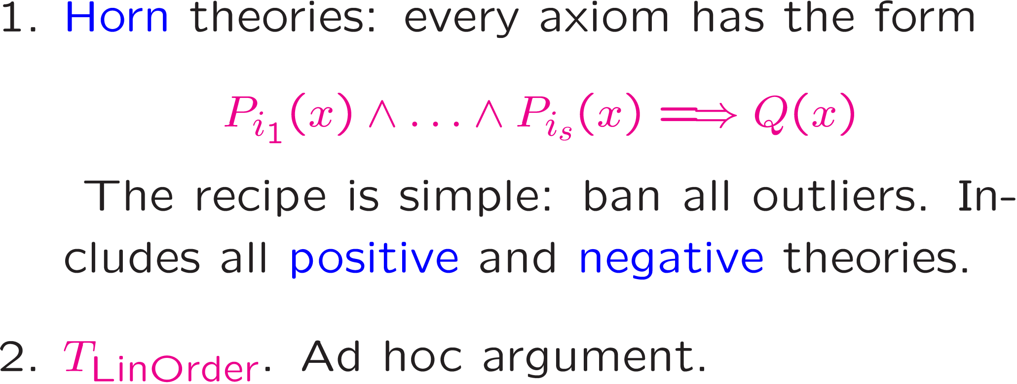
The proof looks simple but it is absolutely non-constructive and uses Axiom of Choice. The resulting strong T –on is not even Borel.
Constructive proofs

Slide 29
Question. Is a constructive proof possible for arbitrary
theories? Or is the possibility to repair weak theons
to actual models equivalent to Axiom of Choice?
[Lovász ?] The theory of graphs with forbidden
induced copies of C₄.
Question. Connections to finite induced removal
lemmas in the style of (say) [Austin Tao 10].

Slide 30
Further topics, II.
Permutons [Hoppen Kohayakawa Moreira Rath Sampaio 13]
Posetons [Janson 11] Limits of interval graphs [Diaconis Holmes Janson 13]
Pe
Permuton
4
μ
Lebesque
σ
3
1
2
Lebesque

Slide 31
Pe
Permuton
4
μ
Lebesque
σ
3
1
2
Lebesque

Slide 33
Existence and uniqueness of permutons can be easily retrieved from this cryptomorphism.
Further topics, III.
Theonic Quasi-Randomness
work in progress

