Slide 1
Tractable Islands Revisited
Rina Dechter
Information and Computer Sciences
UC-Irvine
Notes:
6/11/2019
The title of my talk “Tractable Islands, revisited” it is more of a personal reflection on my research career, which was indeed driven by the “tractable islands” paradigm. In 1994 I gave an invited talk at AAAI (was at Seattle ) titled:
“In search of tractable islands”…. I entertained the idea of giving the same talk (I found hard copy of my slides) which could still be relevant. But I will not. Instead the real title of my took should have been not so fdifferent:
“Exploiting a “single” tractable island for anytime probabilistic reasoning.
So lets start by examining some known tractable islands [next]
Since reasoning tasks are computationally intractable, my primary approach is to devise methods through the understanding and exploitation of tractable reasoning tasks. My previous works on greedy problems, the mechanical generation of heuristics, the identification of tractable constraint models via topological decompositions, and the establishment of boundaries of local computations have been driven by this principal concern. With my students, I analyze algorithms both analytically and empirically using real life applications such as scheduling, planning, and diagnosis.
The use of tractable Island was the Holly grail of addressing AI reasoning early on in AI. The most powerful idea was the use of general search algorithm to solve for problem that are guided by heuristics. Those heuristics can be generated by simplified models, often those that are relaxed into a tractable island.
Tractablity can be used at the level of modeling, generating models that are tractable. Tractability can also be used at the time of reasoning.
In our work we take the approach of working with potentially intractable models, but …
One of the fundamental idA given problem instance can be a member of an island, or can be transformed into one with some cost. And, when the transformation cost is too high (time and especially memory) the problem can be relaxed in to a tractable one.
A problem can be transformed into a tractable oneThe idea iIn particular it isin AI and especially the core idea of how rule of thumbs, or heuristic for search can be generated.

Slide 2
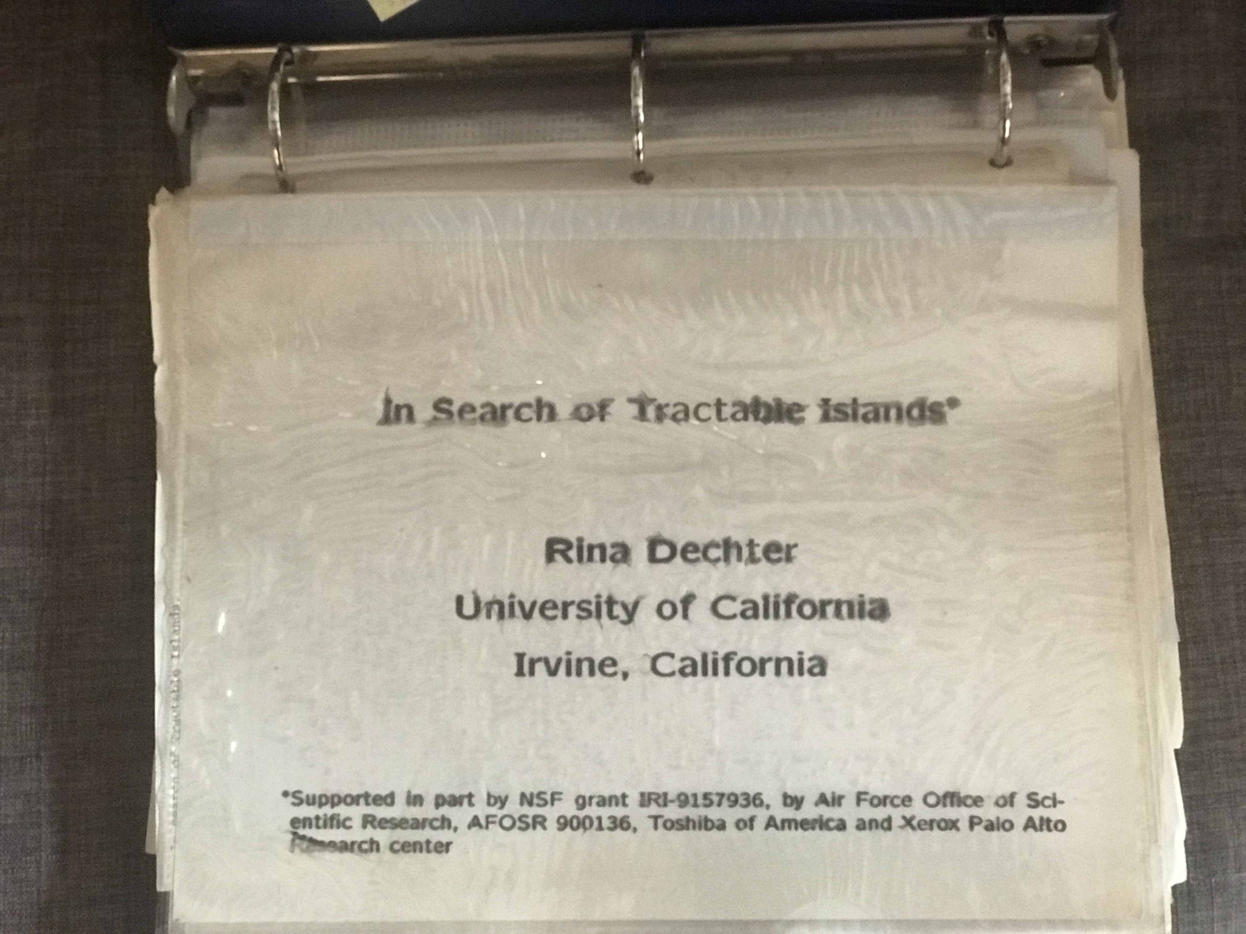
Notes:
“An important component of human problem-solving expertise is the ability to use knowledge about solving easy problems to guide the solution of difficult ones.” - Minsky
A longstanding intuition in AI is that intelligent agents should be able to use solutions to easy problems to solve hard problems. This has often been termed the “tractable island paradigm.” How do we act on this intuition in the domain of probabilistic reasoning?
This talk will describe the status of probabilistic reasoning algorithms that are driven by the tractable islands paradigm when solving optimization, likelihood and mixed (max-sum-product, e.g. marginal map) queries. I will show how heuristics generated via variational relaxation into tractable structures, can guide heuristic search and Monte-Carlo sampling, yielding anytime solvers that produce approximations with confidence bounds that improve with time, and become exact if enough time is allowed.

Slide 3
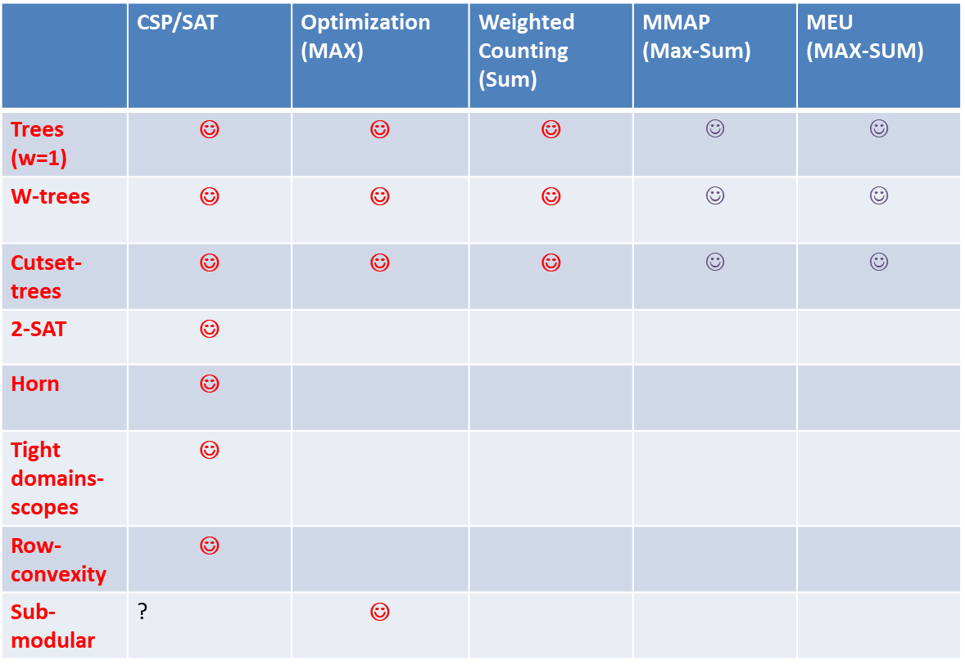
Tractable Islands: Tasks and Methods
Bucket-elimination: Time and space O( n $k^{w}$ ) (dechter 1999)
Cutset-conditioning: is O( n $k^{\#c}$ ) time, linear memory, leading to anytime schemes
 | CSP/SAT | Optimization (MAX) | Weighted Counting (Sum) | MMAP (Max-Sum) | MEU (MAX-SUM)
Trees (w=1) | ☺ | ☺ | ☺ | $$☺$$ | $$☺$$
W-trees | ☺ | ☺ | ☺ | $$☺$$ | $$☺$$
Cutset-trees | ☺ | ☺ | ☺ | $$☺$$ | $$☺$$
2-SAT | ☺
Horn | ☺
Tight domains- scopes | ☺
Row-convexity | ☺
Sub-modular | ? | ☺
Tasks
Tractable
Islands
Graph
based
Language-
based
Mixed
L+G
Notes:
Here are some well known tractable classes for their respective tasks. Tractability was studied extensively for SAT/CSP and there is a full characterization of all the tractable classes associated with “relation” or language”. On the other hand we have tractability based on the graphs structure… trees.
The notion of trees and tree-like seems to be the only one that extends also to optimization and to weighted counting.
All the tractable classes can be realized (solved) polynomially using “inference” namely variable elimination dynamic programming, consistency enforcing. This could be viewed as a universal approach having time and space complexity exponential in the treewidth. I believe that in the context of constraints, at least, it was shown that there the treewidth is the best you can get for structure-based tractability (it can be formalized). But sometime we can exploit structure with less memory is we use conditioning.. So lets look at these two apeacts of getting to a tree:
[next]

Slide 4
Tree-solving is easy
Belief updating (sum-prod)
CSP – consistency (projection-join)
P(X)
P(Y|X)
P(Z|X)
P(T|Y)
P(R|Y)
P(L|Z)
P(M|Z)
MPE (max-prod)
#CSP (sum-prod)
Trees are processed in linear time and memory
Notes:
If the graph of the problem is a tree, linear message passing will work for all the tasks (almost).
But if we do not have a tree we can travel to a tree with some cost.

Slide 5
Traveling to trees via Inference
Traveling to trees by clustering
Distance: n exp(w)
ABC
DGF
A
D
G
B
BDEF
F
C
EFH
E
K
M
H
L
FHK
J
Inference algorithm:
Time: exp(tree-width)
Space: exp(tree-width)
HJ
KLM
treewidth = 4 - 1 = 3
treewidth = (maximum cluster size) - 1
Notes:
Transformation by inference translates to identifying sub-problems, solving each in isolation and the solving a tree of subproblems

Slide 6
Traveling to trees via Conditioning
Traveling to trees by conditioning
Distance: exp(cycle-cutset)
H
H
H
H
G
H
G
G
G
N
G
N
N
N
N
D
D
D
D
F
D
F
F
F
M
F
M
M
M
A
M
A
J
A
J
J
J
O
J
O
O
O
E
A
O
E
E
E
E
C
C
C
C
P
C
P
P
P
B
P
B
B
B
B
K
K
K
L
L
L
K
K
L
L
Cycle cutset = {A,B,C}
B
H
H
G
G
H
N
G
N
N
D
D
F
F
D
M
F
M
J
J
M
O
C
J
O
E
E
O
E
C
P
C
P
P
K
L
K
K
L
L
Notes:
Or, by conditioning. The cost then is exponential in the cycle-cutset size but linear in memory.

Slide 7
Traveling by Inference and Conditioning w-Cutset: Balancing Memory and Time
E
D
M
L
Inference may require too much memory
Condition on some of the variables
W-cutset. Time exp(w+c_w), memory exp(w)
Graph
Coloring
problem
C
A
B
K
H
F
G
J
A=yellow
A=green
B=red
B=blue
B=green
B=red
B=blue
B=yellow
E
D
M
E
D
M
E
D
M
E
D
M
E
D
M
E
D
M
L
L
L
L
L
L
C
C
C
C
C
C
K
K
K
K
K
K
H
H
H
H
H
H
F
F
F
F
F
F
G
J
G
J
G
J
G
J
G
J
G
J
Notes:
And combining conditioning and inference to trade-off memory and time.
Does this reminds you of Gogate’s group work on cutset networks?

Slide 8
Bird's-eye View of Exact Algorithms
Inference
exp(w*) time/space
ABC
DGF
A
B
D
G
BDEF
F
C
E
EFH
H
K
M
L
FHK
J
HJ
KLM
A
A
Search
Exp(w*) time
O(w*) space
0
1
F
B
0
1
0
1
B
C
E
0
1
0
1
0
1
0
1
C
0
1
0
1
0
1
0
1
0
1
0
1
0
1
0
1
D
0
1
0
1
0
1
0
1
0
1
0
1
0
1
0
1
0
1
0
1
0
1
0
1
0
1
0
1
0
1
0
1
E
D
F
0
1
0
1
0
1
0
1
0
1
0
1
0
1
0
1
0
1
0
1
0
1
0
1
0
1
0
1
0
1
0
1
0
1
0
1
0
1
0
1
0
1
0
1
0
1
0
1
0
1
0
1
0
1
0
1
0
1
0
1
0
1
0
1
A=yellow
A=green
Search+inference:
Space: exp(q)
Time: exp(q+c(q))
E
D
M
L
B=blue
B=green
B=red
B=blue
C
A
E
D
M
L
E
D
M
L
E
D
M
L
E
D
M
L
q: user
controlled
B
H
K
C
C
C
C
F
G
J
H
K
H
K
H
K
H
K
F
G
J
F
G
J
F
G
J
F
G
J
Notes:
So overall, the tree-based tractability provide us with schemes for exact reasoning and for approximate reasoning, for trading time and memory wishing to get to exact place if possible,
But can settle for relaxed trees that yield bounds on the results.

Slide 9
Bird's-eye View of Exact Algorithms
Inference
exp(w*) time/space
ABC
DGF
A
B
D
G
BDEF
F
C
E
EFH
H
K
M
L
FHK
J
HJ
KLM
A
A
OR
A
Search
Exp(w*) time
O(w*) space
AND
0
0
1
1
F
B
OR
B
B
0
1
0
1
AND
0
1
0
1
E
0
OR
C
E
C
E
C
E
C
E
B
C
AND
1
0
0
1
0
1
0
1
0
1
C
OR
1
0
1
0
1
0
1
0
1
D
D
F
F
D
D
F
F
AND
0
1
0
1
0
1
0
1
0
1
0
1
D
0
1
0
1
0
1
0
1
0
1
0
0
1
0
1
E
D
1
0
1
0
1
0
1
0
1
0
1
0
1
0
1
0
1
0
1
0
1
F
Context minimal AND/OR search graph
18 AND nodes
0
1
0
1
0
1
0
1
0
1
0
1
0
1
0
1
0
1
0
1
0
1
0
1
0
1
0
1
0
1
0
1
0
1
0
1
0
1
0
1
0
1
0
1
0
1
0
1
0
1
0
1
0
1
0
1
0
1
0
1
0
1
0
1
A=yellow
A=green
Search+inference:
Space: exp(q)
Time: exp(q+c(q))
E
D
M
L
B=blue
B=green
B=red
B=blue
C
A
E
D
M
L
E
D
M
L
E
D
M
L
E
D
M
L
q: user
controlled
B
H
K
C
C
C
C
F
G
J
H
K
H
K
H
K
H
K
F
G
J
F
G
J
F
G
J
F
G
J

Slide 10
Bird's-eye View of Approximate Algorithms
Inference
Bounded Inference
ABC
DGF
A
B
D
G
BDEF
F
C
E
EFH
H
K
M
L
FHK
J
HJ
KLM
A
A
OR
A
Search
Sampling
AND
0
0
1
1
F
B
OR
B
B
0
1
0
1
AND
0
1
0
1
E
0
OR
C
E
C
E
C
E
C
E
B
C
AND
1
0
0
1
0
1
0
1
0
1
C
OR
1
0
1
0
1
0
1
0
1
D
D
F
F
D
D
F
F
AND
0
1
0
1
0
1
0
1
0
1
0
1
D
0
1
0
1
0
1
0
1
0
1
0
0
1
0
1
E
D
1
0
1
0
1
0
1
0
1
0
1
0
1
0
1
0
1
0
1
0
1
F
Context minimal AND/OR search graph
18 AND nodes
0
1
0
1
0
1
0
1
0
1
0
1
0
1
0
1
0
1
0
1
0
1
0
1
0
1
0
1
0
1
0
1
0
1
0
1
0
1
0
1
0
1
0
1
0
1
0
1
0
1
0
1
0
1
0
1
0
1
0
1
0
1
0
1
Search + inference:
Sampling + bounded inference
A=yellow
A=green
E
D
M
L
B=blue
B=green
B=red
B=blue
C
A
E
D
M
L
E
D
M
L
E
D
M
L
E
D
M
L
B
H
K
C
C
C
C
F
G
J
H
K
H
K
H
K
H
K
F
G
J
F
G
J
F
G
J
F
G
J
Notes:
But, by going from exact to approximate we also want to have some gurantee. Yielding the anytime scheme.

Slide 11
Our approach:
Use tractable islands in Reasoning, rather than in Modeling

Slide 12
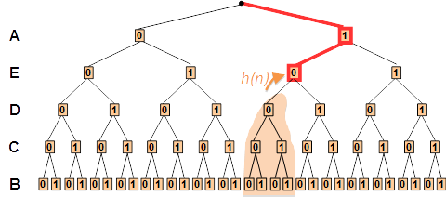
















Anytime Bounds via Tree Search
Desiderata, meaningful confidence interval, responsive, complete
Winning frameworks: search, or sampling guided by heuristics generated via tractable islands.
bucket B:
$$f\left(a,b\right)$$
$$f\left(b,c\right)$$
$$f\left(b,d\right)$$
$$f\left(b,e\right)$$
bucket C:
$$λ_{B→C}(a,c)$$
$$f\left(c,a\right)$$
$$f\left(c,e\right)$$
bucket D:
$$f\left(a,d\right)$$
$$λ_{B→D}(d,e)$$
bucket E:
$$λ_{C→E}(a,e)$$
$$λ_{D→E}(a,e)$$
Bounded error
bucket A:
$$f\left(a\right)$$
$$λ_{E→A}(a)$$
time
Notes:
6/11/2019
Our desire is to have approximations that improve with time and will not be hindered by memory. Approximations that provide error bounds are desirable to give us some idea of how well we do, and if we have enough resources we will that the approximation will improve with time, the error bounds will get tighter and, if enough time is available we can get an exact solution. Also, the capability to trade computational resources with quality in an anytime fashion is important: we want better approximations given more computational resources; and “anytime” also means we can stop at any point to get a reasonable approximation.

Slide 13
Anytime Bounds via Graph Search
Desiderata, meaningful confidence interval, responsive, complete
Winning frameworks: search, or sampling guided by heuristics generated via tractable islands.
OR
A
AND
0
1
OR
B
B
bucket B:
$$f\left(a,b\right)$$
$$f\left(b,c\right)$$
$$f\left(b,d\right)$$
$$f\left(b,e\right)$$
AND
0
1
0
1
OR
C
E
C
E
C
E
C
E
bucket C:
AND
0
1
0
1
0
1
0
1
$$λ_{B→C}(a,c)$$
$$f\left(c,a\right)$$
$$f\left(c,e\right)$$
OR
D
D
D
D
F
F
F
F
AND
bucket D:
0
1
0
1
$$f\left(a,d\right)$$
$$λ_{B→D}(d,e)$$
bucket E:
$$λ_{C→E}(a,e)$$
$$λ_{D→E}(a,e)$$
Bounded error
bucket A:
$$f\left(a\right)$$
$$λ_{E→A}(a)$$
time
Notes:
So, we usually seek for approximations. ( click) Among approximation methods, those provide bounds are often favored because we can quantify the approximation errors. (click) Also, the capability to trade computational resources with quality in an anytime fashion is important: we want better approximations given more computational resources; and “anytime” also means we can stop at any point to get a reasonable approximation. Note that there are two type of bounds, one is deterministic and the other is probabilistic. (clcik) “probabilistic bounds” means the bounds only hold with some probability defined by some confidence parameter \delta.

Slide 14
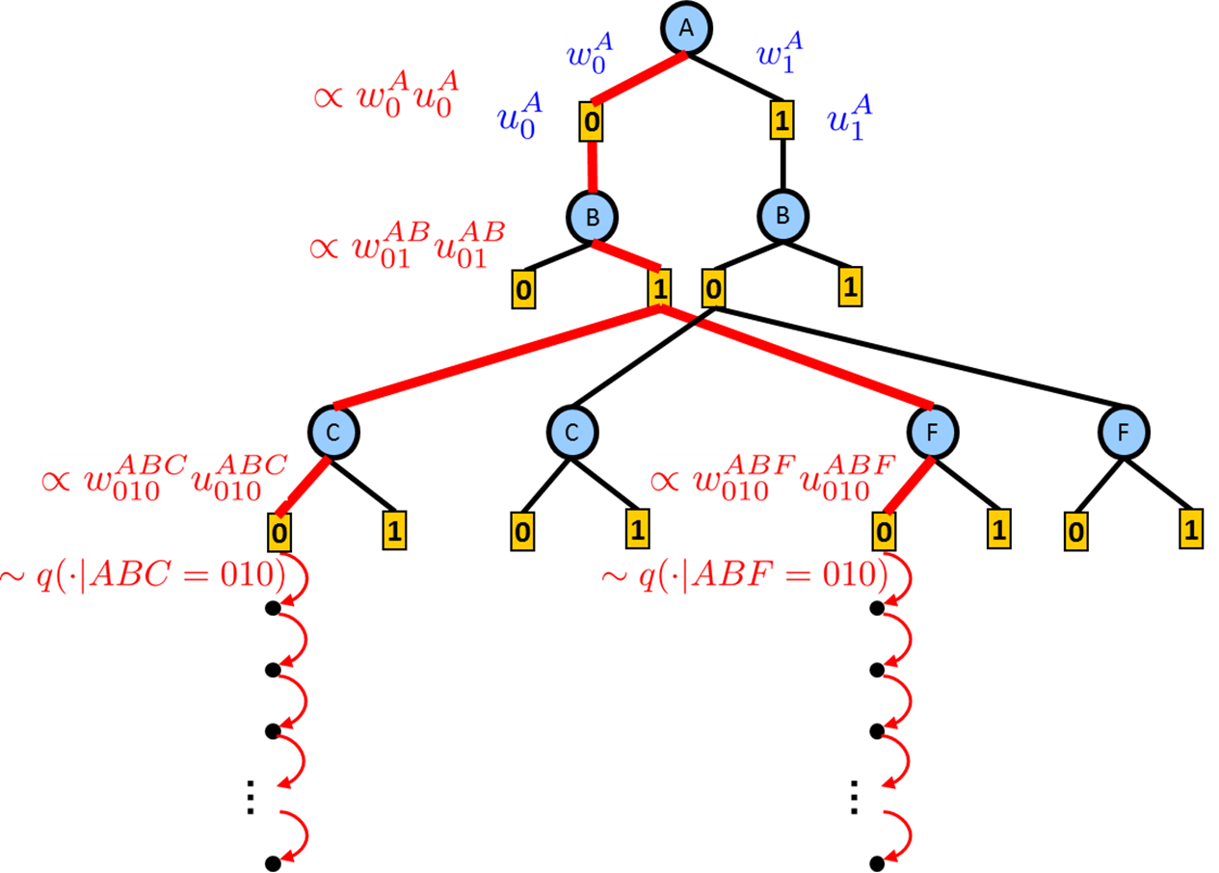
Anytime Bounds via Sampling
Desiderata, meaningful confidence interval, responsive, complete
Winning frameworks: search, or sampling guided by heuristics generated via tractable islands.
bucket B:
$$f\left(a,b\right)$$
$$f\left(b,c\right)$$
$$f\left(b,d\right)$$
$$f\left(b,e\right)$$
bucket C:
$$λ_{B→C}(a,c)$$
$$f\left(c,a\right)$$
$$f\left(c,e\right)$$
bucket D:
$$f\left(a,d\right)$$
$$λ_{B→D}(d,e)$$
bucket E:
$$λ_{C→E}(a,e)$$
$$λ_{D→E}(a,e)$$
Bounded error
bucket A:
$$f\left(a\right)$$
$$λ_{E→A}(a)$$
time
Notes:
So, we usually seek for approximations. ( click) Among approximation methods, those provide bounds are often favored because we can quantify the approximation errors. (click) Also, the capability to trade computational resources with quality in an anytime fashion is important: we want better approximations given more computational resources; and “anytime” also means we can stop at any point to get a reasonable approximation. Note that there are two type of bounds, one is deterministic and the other is probabilistic. (clcik) “probabilistic bounds” means the bounds only hold with some probability defined by some confidence parameter \delta.

Slide 15
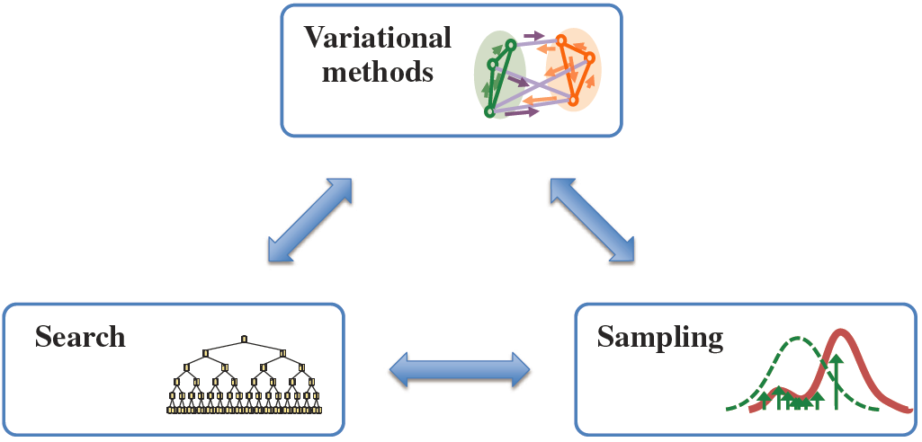
Outline
Graphical models, The Marginal Map task
AND/OR search spaces
Variational bounds as search heuristics
Combining methods: Heuristic Search for Marginal Map
Combining methods: Sampling
Conclusion
Bounded error
Notes:
Principles of good solvers:
Compact Search space, to start with (so even if you search it all it will not be too bad)
Heuristic evaluation function (so you can explore only a small portion of the space)
Search dfs to have anytime performance:
what is a good search space for graphical models
What is a good heuristic evaluation function?
Help DFS to be more like a BFS

Slide 16
Outline
Graphical models, The Marginal Map task
AND/OR search spaces
Variational bounds as search heuristics
Combining methods: Heuristic Search for Marginal Map
Combining methods: Sampling
Conclusion
Bounded error
Notes:
Principles of good solvers:
Compact Search space, to start with (so even if you search it all it will not be too bad)
Heuristic evaluation function (so you can explore only a small portion of the space)
Search dfs to have anytime performance:
what is a good search space for graphical models
What is a good heuristic evaluation function?
Help DFS to be more like a BFS

Slide 17
Graphical Models
A
A
P(A)
P(B|A)
P(C|A)
P(D|A,B)
P(F|B,C)
P(G|D,F)
R(A)
R(A,B)
R(A,C)
R(A,B,D)
R(B,C,F)
R(D,F,G)
B
C
B
C
D
F
D
F
G
G
a) Belief network (directed)
b) Constraint network (undirected)
Oil
sales
Test
cost
Drill
cost
Test
A
B
C
D
Test
result
Drill
Oil
produced
Oil sale
policy
E
F
G
H
Seismic
structure
Oil
underground
Sales
cost
Market
information
I
J
K
L
c) Influence diagram
d) Markov network
Notes:
(technion) Overall, we encounter graphical models in the following forms: probabilistic and directed, causal and not,
Determistic specifying a set of constraints/relations or Boolean formulas.
Here I want to focus on Boolean/symbolic
And Bayesian which are directed and probabilistic and on their mixture.
**********************************
We have belief networks to allow reasoning under conditions of uncertainty, vs constraint networks describing a collection of restriction on
The domain and goals that must be satisfied by every scenario or a solution.
If we also want to capture the decision process we add to the Bayesian network actions, and utilities or penalties. In this case we wish to find a set
of actions that maximize the expected utility, and, finally to accommodate situation assessment and planning over time we can use the model
Of dynamic Bayesian networks, or, with actions, Markov decision processes.

Slide 18
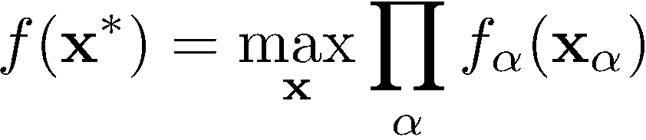
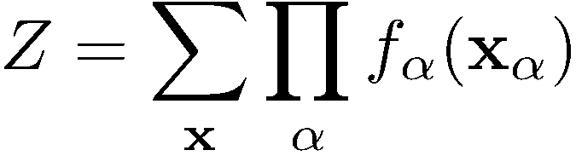
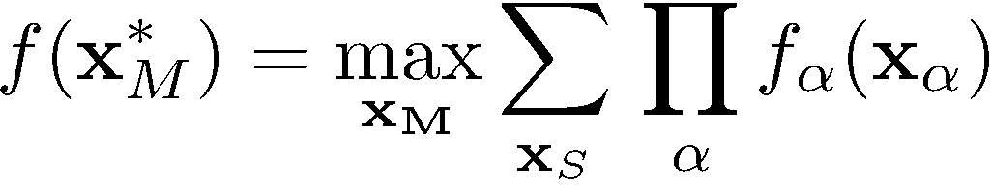
Probabilistic Reasoning Problems
Tasks:
  Combinatorial search / counting queries
  Exact reasoning NP-complete (or worse)
Max-Inference
(most likely config.)
Sum-Inference
(data likelihood)
Harder
Mixed-Inference
(optimal prediction)

Slide 19
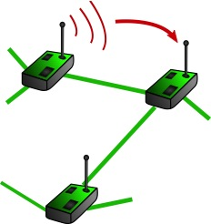
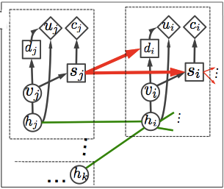
Why Marginal MAP?
Often, Marginal MAP is the “right” task:
  We have a model describing a large system
  We care about predicting the state of some part
Example: decision making
  Sum over random variables (random effects, etc.)
  Max over decision variables (specify action policies)
  Complexity: NP^{pp} complete
  Not necessarily easy on trees
Sensor network
Influence diagram:

Slide 20
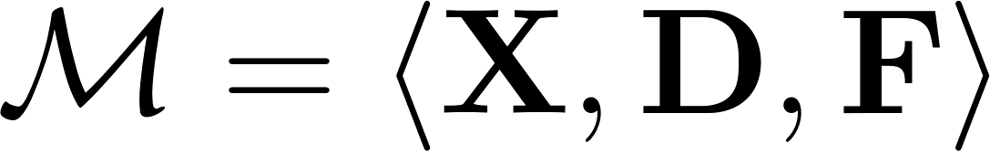
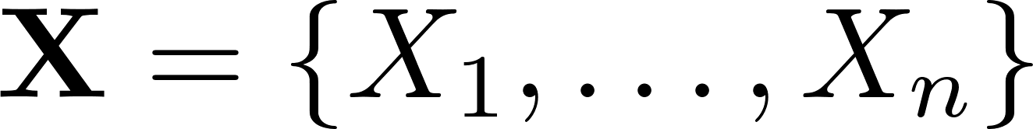

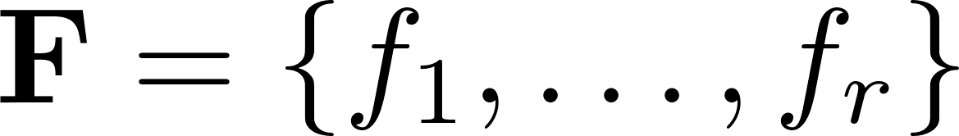
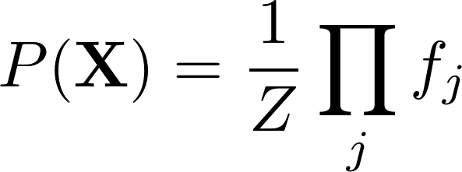
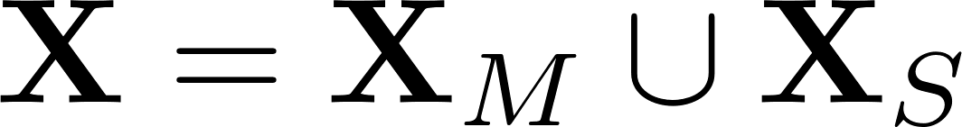
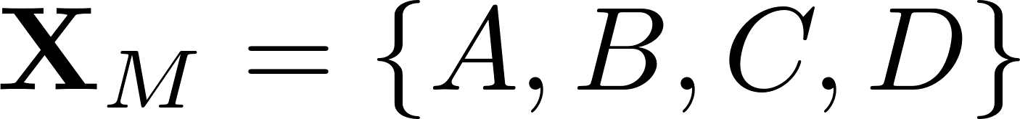
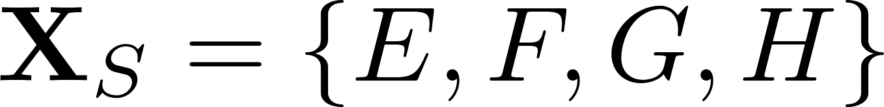
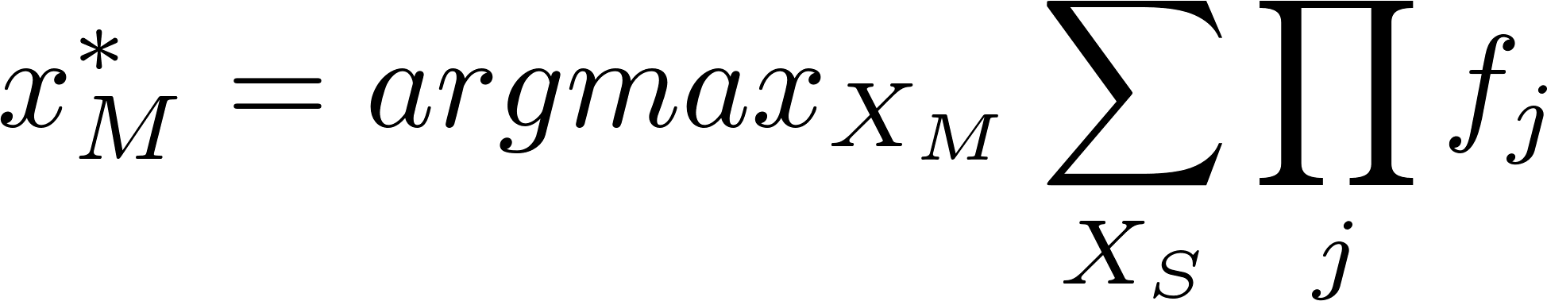
Marginal Map
primal graph
E
C
Graphical Model:
  variables
  domains
  functions
Marginal MAP task:
A
B
H
F
D
G
Why is it harder? intuitively
Notes:
In many cases, especially in diagnosis and planning we are interested in finding the most likely configuration of a subset of the variables given the evidence.
This task is called Marginal Map, requires summation over a subset of the variables and marginalization over the remainder.
Here is a small example.
Clearly, some planning task fall into this category: in conformant planning when formulated appropriately we ask to find an assignment to a set of action variables that is most likely to reach the goal.
Why is it hard?

Slide 21
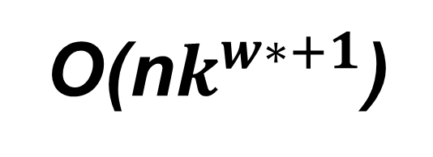
Finding Marginals by Bucket Elimination
Algorithm BE-bel (Dechter 1996)
A
B
C
D
E
Elimination operator
bucket B:
P(b|a) P(d|b,a) P(e|b,c)
Time and space exponential in the induced-width / treewidth
B
bucket C:
P(c|a)
C
bucket D:
O(n$k^{w∗+1}$)
D
bucket E:
e=0
W*=4
”induced width”
(max clique size)
E
bucket A:
P(a)
A
P(e=0)
P(a|e=0)
Notes:
So lets examine perhaps the most popular eact inference by variable elimination for MAR/P€ first.

Slide 22
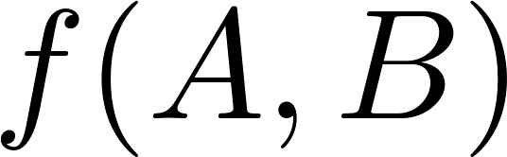
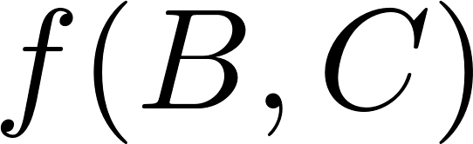
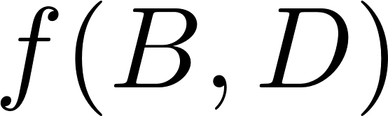
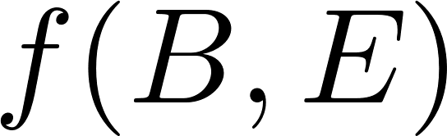
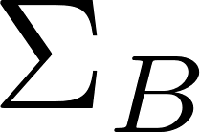
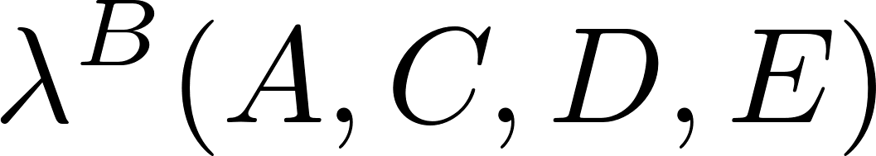
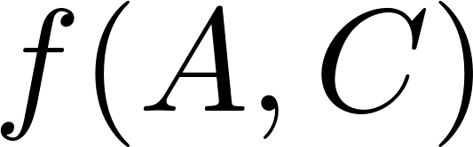
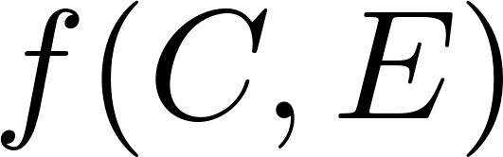
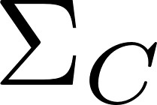
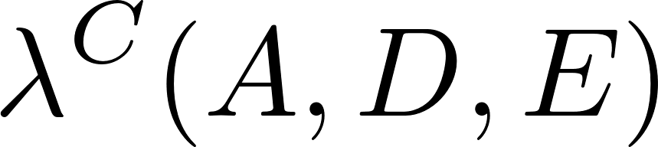
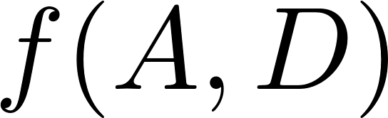
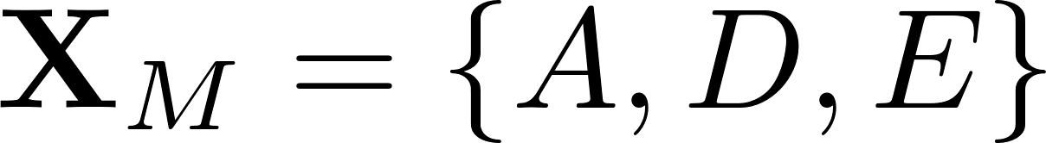
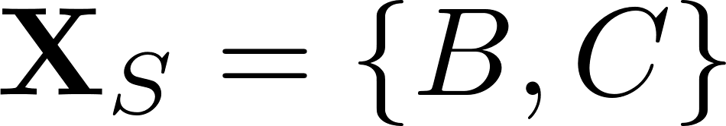

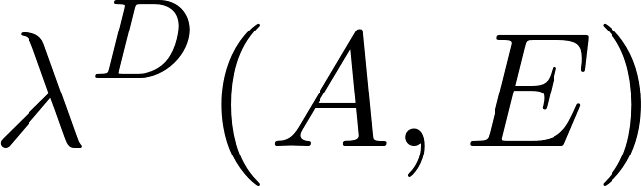
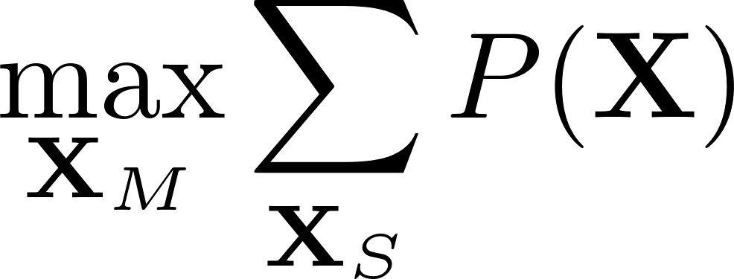

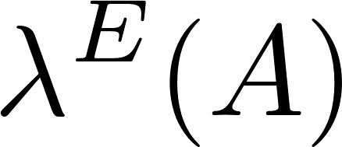
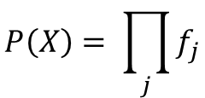
Why is MMAP Harder for Inference (BE)?
Let’s apply Bucket-elimination: Complexity is exponential in the *constrained* induced-width
A
B:
SUM
B
C
C:
D
constrained elimination order
E
D:
MAX
E:
A:
$$P\left(X\right)= \prod_{j}{f_{j}}$$
MAP* is the marginal MAP value
Notes:
For MMAP it is harder because it forces a aconstaint on variable ordering.
Why is it harder?
Intuitively lets consider a classic message-passing algorithm like bucket-elimination to solve the problem. Since we have to marginalize the summation variable first, the order of processing is restricted.

Slide 23
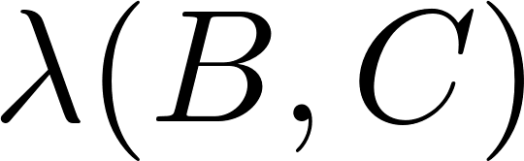
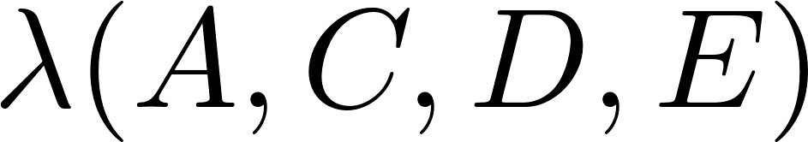
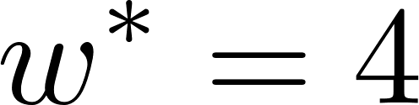
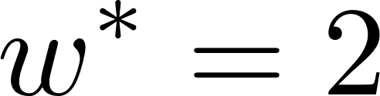
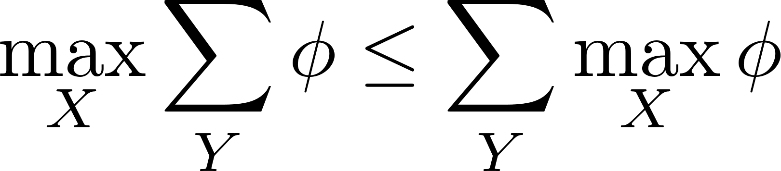
Why is MMAP Harder for Inference (BE)?
exact
upper bound
A
B
E
SUM
C
D
B
C
D
unconstrained elimination order
constrained elimination order
C
D
E
E
B
MAX
A
A
In practice, constrained induced is much larger!
(Park & Darwiche, 2003)
(Yuan & Hansen, 2009)

Slide 24
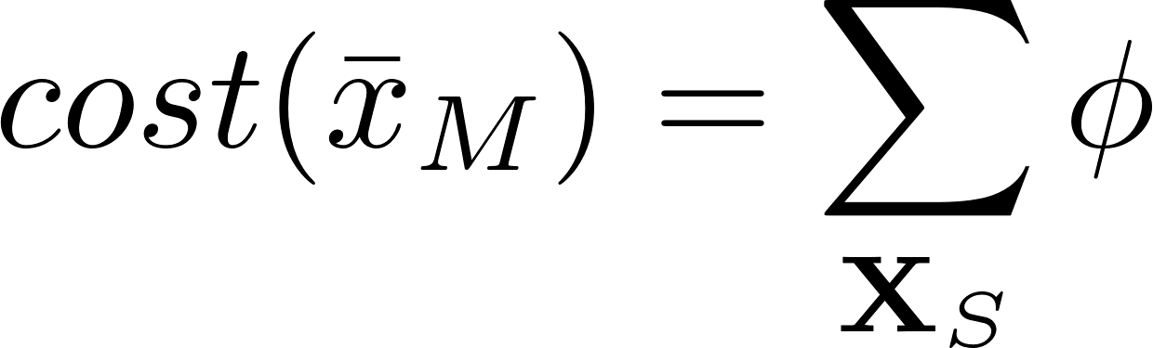
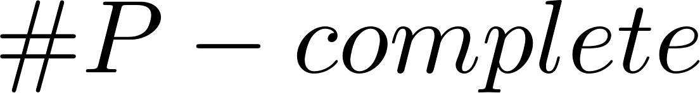
Why is MMAP Harder for Search?
Brute-Force Search
Enumerate all full MAP assignments
Evaluate each full MAP assignment
Return the one with maximum cost
MAP
Evaluating a MAP assignment is hard!
Harder relative to optimization because induced-width is higher and
evaluation of a configuration is higher
Harder relative to summation: higher induced-width

Slide 25
For anytime behavior we need conditioning
→ Search
AND/OR Search Spaces for Graphical Models
And, if possible, lets exploit structure in the search space as well.
Notes:
So, we would like to use tractable islands but improve on them using search.
So the first thing is also to exploit structure in the search space.

Slide 26
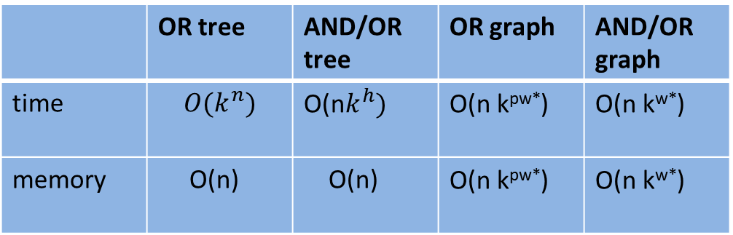
Potential search spaces
Pseudo-tree
[ ]
A
A | B | f₁
0 | 0 | 2
0 | 1 | 0
1 | 0 | 1
1 | 1 | 4
A | C | f₂
0 | 0 | 3
0 | 1 | 0
1 | 0 | 0
1 | 1 | 1
A | E | f₃
0 | 0 | 0
0 | 1 | 3
1 | 0 | 2
1 | 1 | 0
A | F | f₄
0 | 0 | 2
0 | 1 | 0
1 | 0 | 0
1 | 1 | 2
B | C | f₅
0 | 0 | 0
0 | 1 | 1
1 | 0 | 2
1 | 1 | 4
B | D | f₆
0 | 0 | 4
0 | 1 | 2
1 | 0 | 1
1 | 1 | 0
B | E | f₇
0 | 0 | 3
0 | 1 | 2
1 | 0 | 1
1 | 1 | 0
C | D | f₈
0 | 0 | 1
0 | 1 | 4
1 | 0 | 0
1 | 1 | 0
E | F | f₉
0 | 0 | 1
0 | 1 | 0
1 | 0 | 0
1 | 1 | 2
C
A
F
[A]
B
[AB]
[AB]
D
B
E
C
E
[CB]
[EA]
D
F
pseudo tree
A
0
1
A
0
1
B
B
0
1
0
1
0
1
0
1
C
 | OR tree | AND/OR tree | OR graph | AND/OR graph
time | $${O(k}^{n})$$ | O(n$k^{h})$ | O(n k^{pw*}) | O(n k^{w*})
memory | O(n) | O(n) | O(n k^{pw*}) | O(n k^{w*})
C
0
1
0
1
0
1
0
1
0
1
0
1
0
1
0
1
D
0
1
0
1
0
1
0
1
0
1
0
1
0
1
0
1
D
0
1
0
1
0
1
0
1
E
0
1
0
1
0
1
0
1
0
1
0
1
0
1
0
1
0
1
0
1
0
1
0
1
0
1
0
1
0
1
0
1
E
0
1
0
1
F
0
1
0
1
0
1
0
1
0
1
0
1
0
1
0
1
0
1
0
1
0
1
0
1
0
1
0
1
0
1
0
1
0
1
0
1
0
1
0
1
0
1
0
1
0
1
0
1
0
1
0
1
0
1
0
1
0
1
0
1
0
1
0
1
F
0
1
Full OR search tree
126 nodes
Context minimal OR search graph
28 nodes
OR
A
AND
0
1
OR
A
OR
AND
0
1
B
B
OR
B
B
AND
0
1
0
1
AND
0
1
0
1
OR
C
E
C
E
C
E
C
E
OR
C
E
C
E
C
E
C
E
AND
0
1
0
1
0
1
0
1
0
1
0
1
0
1
0
1
AND
0
1
0
1
0
1
0
1
OR
D
D
D
D
F
F
D
D
D
D
F
F
OR
D
D
F
F
D
D
F
F
F
F
F
F
AND
0
1
0
1
AND
0
1
0
1
0
1
0
1
0
1
0
1
0
1
0
1
0
1
0
1
0
1
0
1
0
1
0
1
0
1
0
1
Full AND/OR search tree
54 AND nodes
Any query can be computed
over any of the search spaces
Context minimal AND/OR search graph
18 AND nodes
Notes:
A search space represents an organized collection of partial configurations, traversed by a search algorithm. Given a problem graph, in a so-called OR search space we instantiate variables one after another. A more efficient approach would be to take advantage of the conditional independencies in the problem, by traversing an AND/OR search space. Here after instantiating variables A and B, the search space is split into two independent parts. Further efficiency gains can be made by eliminating repeating subproblems, resulting in context-minimal search graph, for both OR and AND/OR cases, often substantially reducing search space size.
*Kalev: I think the pseudo-tree should be back in. It clarifies the whole idea of AND/OR. I added.

Slide 27
Cost of a Solution Tree
A
A
A | B | E=0 | E=1
0 | 0 | .4 | .6
0 | 1 | .5 | .5
1 | 0 | .7 | .3
1 | 1 | .2 | .8
A | B=0 | B=1
0 | .4 | .6
1 | .1 | .9
A | C=0 | C=1
0 | .2 | .8
1 | .7 | .3
A | P(A)
0 | .6
1 | .4
B
B
C
E
C
Evidence: E=0
E
D
D
OR
.6
A
.4
AND
0
1
OR
B
B
.4
.6
.1
.9
AND
0
1
0
1
OR
E
C
E
C
E
C
E
C
.4
.2
.8
.5
.2
.8
.7
.1
.9
.2
.1
.9
AND
0
1
0
1
0
1
0
1
0
1
0
1
0
1
0
1
OR
D
D
D
D
D
D
D
D
.8
.9
.7
.5
.8
.9
.7
.5
AND
0
1
0
1
0
1
0
1
0
1
0
1
0
1
0
1
B | C | D=0 | D=1
0 | 0 | .2 | .8
0 | 1 | .1 | .9
1 | 0 | .3 | .7
1 | 1 | .5 | .5
Cost of the solution tree: the product of weights on its arcs
Cost of (A=0,B=1,C=1,D=1,E=0) = 0.6 · 0.6 · 0.5 · 0.8 · 0.5 = 0.0720
Evidence: D=1
Notes:
Value of each node is the number of solutions below it …
If we cache, we search the graph, so all the algorithms have these time and space complexities.
Add another slide
Linear space
Full caching
+ anything in between

Slide 28

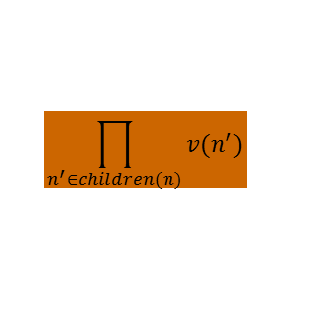
Value of a Node (e.g., Probability of Evidence)
A
A
A | B | E=0 | E=1
0 | 0 | .4 | .6
0 | 1 | .5 | .5
1 | 0 | .7 | .3
1 | 1 | .2 | .8
A | B=0 | B=1
0 | .4 | .6
1 | .1 | .9
A | C=0 | C=1
0 | .2 | .8
1 | .7 | .3
A | P(A)
0 | .6
1 | .4
B
B
C
E
C
P(D=1,E=0)=?
D
Evidence: E=0
E
D
OR
.24408
A
.6
.4
AND
.3028
.1559
0
1
OR
.3028
.1559
.4
B
.6
.1
B
.9
AND
.352
.27
.623
.104
0
1
0
1
OR
.4
.88
.5
.54
.7
.89
.2
.52
E
C
E
C
E
C
E
C
.4
.2
.8
.5
.2
.8
.7
.1
.9
.2
.1
.9
AND
0
1
.8
.9
.7
.5
.8
.9
.7
.5
0
1
0
1
0
1
0
1
0
1
0
1
0
1
OR
.8
.9
.7
.5
.8
.9
.7
.5
D
.8
D
.9
D
.7
D
.5
D
.8
D
.9
D
.7
D
.5
AND
0
1
0
1
0
1
0
1
0
1
0
1
0
1
0
1
Value of node = updated belief for sub-problem below
B | C | D=0 | D=1
0 | 0 | .2 | .8
0 | 1 | .1 | .9
1 | 0 | .3 | .7
1 | 1 | .5 | .5
$$\prod_{n^{′}∈children(n)}{v(n^{′})}$$
AND node: product
$$\sum_{n′∈children(n)}{w\left(n,n^{′}\right) v(n^{′})}$$
OR node: Marginalization by summation
Evidence: D=1
Notes:
Value of each node is the number of solutions below it …
If we cache, we search the graph, so all the algorithms have these time and space complexities.
Add another slide
Linear space
Full caching
+ anything in between

Slide 29
Answering Queries: Sum-Product(Belief Updating)
Context
A
A
[ ]
A | B | E=0 | E=1
0 | 0 | .4 | .6
0 | 1 | .5 | .5
1 | 0 | .7 | .3
1 | 1 | .2 | .8
A | B=0 | B=1
0 | .4 | .6
1 | .1 | .9
A | C=0 | C=1
0 | .2 | .8
1 | .7 | .3
A | P(A)
0 | .6
1 | .4
B
C
B
[A]
Result: P(D=1,E=0)
[AB]
E
C
[AB]
Evidence: E=0
E
D
[BC]
.24408
A
D
.6
.4
.3028
.1559
0
1
.3028
.1559
.4
B
.6
.1
B
.9
.352
.27
.623
.104
0
1
0
1
.4
.88
.5
.54
.7
.89
.2
.52
E
C
E
C
E
C
E
C
.4
.2
.8
.5
.2
.8
.7
.1
.9
.2
.1
.9
0
1
.8
.9
.7
.5
.8
.9
.7
.5
0
1
0
1
0
1
0
1
0
1
0
1
0
1
.8
.9
.7
.5
D
.8
D
.9
D
.7
D
.5
B | C | Value
0 | 0 | .8
0 | 1 | .9
1 | 0 | .7
1 | 1 | .1
0
1
0
1
0
1
0
1
B | C | D=0 | D=1
0 | 0 | .2 | .8
0 | 1 | .1 | .9
1 | 0 | .3 | .7
1 | 1 | .5 | .5
Cache table for D
Evidence: D=1
Notes:
Value of each node is the number of solutions below it …
If we cache, we search the graph, so all the algorithms have these time and space complexities.
Add another slide
Linear space
Full caching
+ anything in between

Slide 30
AND/OR w-Cutset
Start from a pseudo-tree, terminate when reaching a cutset, and apply inference
E
D
E
D
E
D
E
D
M
M
M
M
C
A
L
C
L
C
L
L
B
K
B
K
K
F
H
F
H
F
H
F
H
G
J
G
J
G
J
J
A
A
A
A
B
K
B
K
B
K
B
K
C
G
L
C
G
L
C
G
L
C
G
L
D
F
M
D
F
M
D
F
M
D
F
M
E
H
E
H
E
H
E
H
J
J
J
J
A pseudo-tree
3-cutset
start pseudo tree
2-cutset
start pseudo tree
1-cutset
start pseudo tree

Slide 31
Time vs Space for w-cutset
(Dechter and El-Fatah, 2000)
(Larrosa and Dechter, 2001)
(Rish and Dechter 2000)
Random Graphs (50 nodes, 200 edges, average degree 8, w*≈23)
60
Branch and bound
50
40
Bucket
elimination
W+c(w)
30
20
time
10
0
-1
2
5
8
11
14
17
20
23
26
29
32
w-cutset time O(exp(w+cutset-size))
Space O(exp(w))
w
space

Slide 32
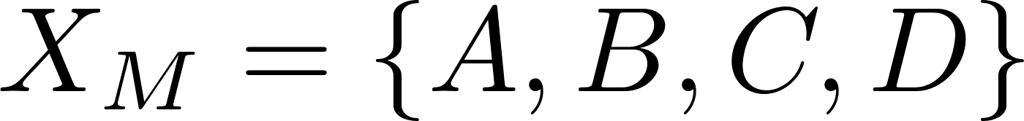
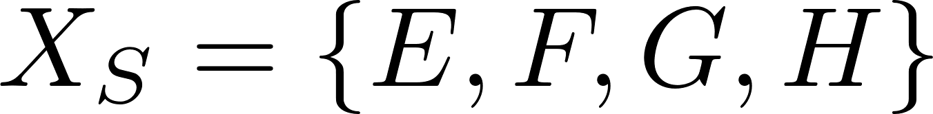
AND/OR search for Marginal MAP
A
E
C
B
MAP variables
A
B
H
C
D
F
D
G
E
G
F
SUM variables
primal graph
H
constrained pseudo tree
A
0
1
Node types
  OR (MAP): max
  OR (SUM): sum
  AND: multiplication
B
B
0
1
0
1
C
D
C
D
C
D
C
D
0
1
0
1
0
1
0
1
0
1
0
1
0
1
0
1
E
E
G
F
E
E
G
F
E
E
G
F
E
E
G
F
0
1
0
1
0
1
0
1
0
1
0
1
0
1
0
1
0
1
0
1
0
1
0
1
0
1
0
1
0
1
0
1
H
H
H
H
0
1
0
1
0
1
0
1
[Marinescu, Dechter and Ihler, 2014]
Notes:
So, the extension of AND/OR search to marginal map is straightforward. We just need to abide by a legitimate orderings, or legitimate pseudo-trees.

Slide 33

AND/OR Search for Marginal MAP
E
C-induced-width = 6
Induced-width = 2
A
E
C
F
B
MAP variables
H
A
B
H
G
C
D
A
F
D
G
E
For MMAP search space is:
$k^{h_{c}}$ on a AND/OR tree
$k^{w_{c}}$ on AND/OR graph
G
F
SUM variables
C
primal graph
H
constrained pseudo tree
B
A
D
0
1
B
B
0
1
0
1
E,F,G,H
C
D
C
D
C
D
C
D
0
1
0
1
0
1
0
1
0
1
0
1
0
1
0
1
E
E
G
F
E
E
G
F
E
E
G
F
E
E
G
F
0
1
0
1
0
1
0
1
0
1
0
1
0
1
0
1
0
1
0
1
0
1
0
1
0
1
0
1
0
1
0
1
A,B,C,D
H
H
H
H
0
1
0
1
0
1
0
1
[Marinescu, Dechter and Ihler, 2014]
Notes:
So, the extension of AND/OR search

Slide 34
For anytime behavior we need conditioning
And we need heuristics to guide search
Generating Heuristic Using Relaxed Tractable Models

Slide 35
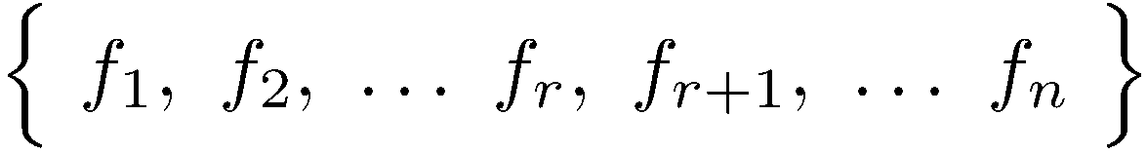
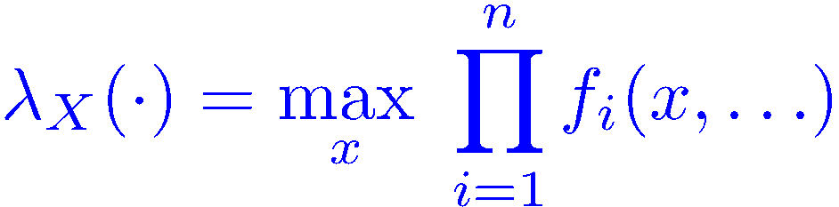
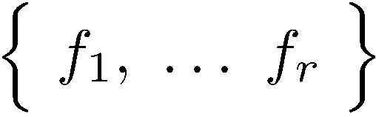




Mini-Bucket Approximation
For optimization
Split a bucket into mini-buckets ―> bound complexity
bucket (X) =
Exponential complexity decrease:
Notes:
As we know many inference algorithms including variable elimination, and message-passing schemes are characterized by processing a set of functions by some combination and marginalization operation to generate a new function, and this is the costly computation, both time and space. So a straightforward idea is to partition, or decompose the set of functions and process each one separately. This is the idea of the mini-bucket scheme.

Slide 36













Mini-Bucket Elimination
[Dechter & Rish 2003]
mini-buckets
For optimization
bucket B:
A
bucket C:
B
C
bucket D:
bucket E:
D
E
bucket A:
A
U = upper bound
B’
C
B
D
E

Slide 37


Mini-Bucket Decoding
For optimization
mini-buckets
B:
C:
D:
E:
A:
U = upper bound
Greedy configuration = lower bound

Slide 38
Properties of Mini-Bucket Eliminaton
(For optimization)
Bounding from above and below
Complexity: O(r exp(i)) time and O(exp(i)) space.
Accuracy: determined by Upper/Lower bound.
As i increases, both accuracy and complexity increase.
Possible use of mini-bucket approximations:
  As anytime algorithms
  As heuristics in search
Relaxation upper bound by mini-bucket
i=2
i=5
i=10
i=20
MAP
Consistent solutions ( greedy search)

Slide 39


















Tightening the Bound
Add factors that “adjust”
each local term, but
cancel out in total
Bound solution using decomposed optimization
Solve independently: optimistic bound
Tighten the bound by re-parameterization
  Enforces lost equality constraints using Lagrange multipliers
Reparameterization:

Slide 40
Tightening the bound
Add factors that “adjust”
each local term, but
cancel out in total
Many names for the same class of bounds
  Dual decomposition [Komodakis et al. 2007]
  TRW, MPLP [Wainwright et al. 2005; Globerson & Jaakkola 2007]
  Soft arc consistency [Cooper & Schiex 2004]
  Max-sum diffusion [Warner 2007]
Reparameterization:

Slide 41
Mini-Bucket with Moment-Matching
[Ihler et al. 2012]
Downward pass as cost shifting
Can also do cost shifting within mini-buckets:
  “Join graph” message passing
“Moment-matching” version:
    One message exchange within each bucket, during downward sweep
Optimal bound defined by cliques (“regions”) and cost-shifting f’n scopes (“coordinates”)
Join graph:
B:
{A,B,C}
{A}
{B,D,E}
{A,C}
C:
{A,C,E}
{D,E}
D:
{A,E}
{A,D,E}
E:
{A,E}
{A}
{A}
A:
{A}
U = upper bound
Notes:
Many methods that can optimize the bound: coordinate descent, sub-gradient descendent and so on. There are many algorithms, such as soft-arc-consistenct, TRW-BP, MPLP, Dual decomposition

Slide 42

Anytime Approximation
Can tighten the bound in various ways
  Cost-shifting (improve consistency between cliques)
  Increase i-bound (higher order consistency)
Simple moment-matching step improves bound significantly

Slide 43

Anytime Approximation
Can tighten the bound in various ways
  Cost-shifting (improve consistency between cliques)
  Increase i-bound (higher order consistency)
Simple moment-matching step improves bound significantly

Slide 44

Anytime Approximation
Can tighten the bound in various ways
  Cost-shifting (improve consistency between cliques)
  Increase i-bound (higher order consistency)
Simple moment-matching step improves bound significantly

Slide 45





Mini-Bucket for Summation
(Liu &Ihler, 2011)
Generalize technique to sum via Holder’s inequality:
Define the weighted (or powered) sum:
  “Temperature” interpolates between sum & max:
  Different weights do not commute:
Notes:
Mini-bucket turns out to be very weak for summations. But we can use another bound called Holder inequality. When w goes to 0 the power-sum becomes a maximization, to 0- is it minimization. If we distribute w1=1 and w2=0 we imitate the original mini-bucket that applied summations to some of the queries and maximization to others.
But now we have a new control parameter that we can adjust and try to optimize to tighten the bound.

Slide 46




















WMB for Marginal MAP
Marginal MAP
mini-buckets
$$λ_{B→C}\left(a,c\right)= \sum_{b}^{w_{1}}{f\left(a,b\right)f(b,c)}$$
$$Σ_{B}$$
bucket B:
$$f\left(a,b\right)$$
$$f\left(b,c\right)$$
$$f\left(b,d\right)$$
$$f\left(b,e\right)$$
$$λ_{B→D}\left(d,e\right)= \sum_{b}^{w_{2}}{f\left(b,d\right)f(b,e)}$$
$$Σ_{C}$$
bucket C:
$$λ_{B→C}(a,c)$$
$$f\left(a,c\right)$$
$$f\left(c,e\right)$$
.
$$(w_{1}+w_{2}=1)$$
.
max_{D}
bucket D:
.
$$f\left(a,d\right)$$
$$λ_{B→D}(d,e)$$
$$λ_{E→A}\left(a\right)=\max_{e}{λ_{C→E}\left(a,e\right)λ_{D→E}(a,e)}$$
max_{E}
bucket E:
$$λ_{C→E}(a,e)$$
$$λ_{D→E}(a,e)$$
$$U=\max_{a}{f\left(a\right)λ_{E→A}(a)}$$
max_{A}
bucket A:
$$f\left(a\right)$$
$$λ_{E→A}(a)$$
Can optimize over cost-shifting and weights
(single pass “MM” or iterative message passing)
U = upper bound
[Liu and Ihler, 2011; 2013]
[Dechter and Rish, 2003]

Slide 47
Outline
Graphical models, The Marginal Map task
AND/OR search spaces
Variational bounds as search heuristics
Combining methods: Heuristic Search for Marginal Map
Combining methods: Sampling
Conclusion
Bounded error
Notes:
Principles of good solvers:
Compact Search space, to start with (so even if you search it all it will not be too bad)
Heuristic evaluation function (so you can explore only a small portion of the space)
Search dfs to have anytime performance:
what is a good search space for graphical models
What is a good heuristic evaluation function?
Help DFS to be more like a BFS

Slide 48

AND/OR Search for Marginal MAP
A
E
C
B
MAP variables
A
B
H
C
D
E
G
F
F
D
G
SUM variables
primal graph
H
constrained pseudo tree
A
mini-buckets
0
1
B
B
$$f\left(a,b\right)$$
$$f\left(b,c\right)$$
$$f\left(b,d\right)$$
0
1
0
1
C
D
C
D
C
D
C
D
h
$$λ_{B→C}(a,c)$$
$$f\left(a,c\right)$$
$$f\left(c,e\right)$$
0
1
0
1
0
1
0
1
0
1
0
1
0
1
0
1
$$λ_{B→D}(d,e)$$
E
E
G
F
E
E
G
F
E
E
G
F
E
E
G
F
$$f\left(a,d\right)$$
0
1
0
1
0
1
0
1
0
1
0
1
0
1
0
1
0
1
0
1
0
1
0
1
0
1
0
1
0
1
0
1
$$λ_{C→E}(a,e)$$
$$λ_{D→E}(a,e)$$
H
H
H
H
0
1
0
1
0
1
0
1
$$f\left(a\right)$$
$$λ_{E→A}(a)$$
[Marinescu, Dechter and Ihler, 2014]
Notes:
Got to slide 44 after 35 minutes

Slide 49
Exact MMAP Solvers: Best or Depth-First Search?
Depth-First search
A
0
1
B
B
0
1
0
1
n
C
D
C
D
C
D
C
D
0
1
0
1
0
1
0
1
0
1
0
1
0
1
0
1
E
E
G
F
E
E
G
F
E
E
G
F
E
E
G
F
The MAP search space
0
1
0
1
0
1
0
1
0
1
0
1
0
1
0
1
0
1
0
1
0
1
0
1
0
1
0
1
0
1
0
1
H
H
H
H
Lower bound
0
1
0
1
0
1
0
1
Best-First search
A,B,C,D
Best-first search expands
less full MAP configurations
Less conditional sums
E,F,G,H
upper bound
Notes:
The depth-first search dives deeper into the search space and it provides a lower bound, or suboptimal solutions. However, it does not provide any upper bound by itself.
The best-first search expands search space by generating the node based on the heuristic evaluation of nodes at the frontiers. It doesn’t provide lower bound until it terminates search.
best-first search expands the least number of nodes yet it requires exponential memory and depth-first search expands much more nodes, however it only requires linear memory.
When we combine both,
The depth-first search will facilitate the best-first search in the following manner. The lower bound can be used to cutoff the frontier maintained by Best-first and the depth-first lookahead of the search space will learn more accurate heuristic
By utilizing the improved heuristic, Best-first could guide Depth-first to the search space that could lead to improved solutions and more frequent solution updates.
This positive cycle between Best+Depth first would improve anytime performance for finding both upper/ lower bounds. And optimality is proven when the global lower bound equals global upper bound

Slide 50
MMAP: Exact AND/OR solvers
Benchmarks:
Grids (128)
Pedigrees (88)
Promedas (100)
AOBF
RBFAOO - recursive
BRAOBB
Yuan, Park BBTDi, BBBTD
Time-bound 2 hours
AND/OR search+ MB-heuristic are superior
to OR search using “unordered heuristic” [Park and Darwiche 2003, Yuan and Hansen 2009] when the constrained induced-width is not bounded.
Best-first schemes are better because less summations evaluation
Notes:
For the bar graph:
Figure 4: The number of instances returned with the optimal solution from 3 problem domains. Easy
and hard problem instances are combined into a single group. The horizontal axis is the
i-bound of WMB-MM(i) heuristic function and the vertical axis is the normalized count
on the instances returned with the optimal solution in 2 hour time limit. AND/OR search
algorithms solved more instances than OR search algorithms, and RBFAOO solved the
largest number of instances at all domains over all i-bounds.

Slide 51
Anytime Solvers for Marginal MAP
Weighted A* search [Pohl 1970]
non-admissible heuristic
Evaluation function:
  f(n)=g(n)+w∙h(n)
Guaranteed w-optimal solution, cost C ≤ w∙C*
Weighted Heuristic: [Lee et. al. AAAI-2016, JAIR 2019]
  Weighted Restarting AOBF (WAOBF)
  Weighted Restarting RBFAOO (WRBFAOO)
  Weighted Repairing AOBF (WRAOBF)
Interleaving Best and depth-first search: (Marinescu et. al AAAI-2017)
  Look-ahead (LAOBF),
  alternating (AAOBF)
Exploiting heuristic
search ideas
Lower bound
Upper bound
Goal: anytime bounds
And anytime solution
MMAP
Notes:
The depth-first search will facilitate the best-first search in the following manner. The lower bound can be used to cutoff the frontier maintained by Best-first and the depth-first lookahead of the search space will learn more accurate heuristic
By utilizing the improved heuristic, Best-first could guide Depth-first to the search space that could lead to improved solutions and more frequent solution updates.
This positive cycle between Best+Depth first would improve anytime performance for finding both upper/ lower bounds. And optimality is proven when the global lower bound equals global upper bound
******************
We now explore schemes that combine best-first and depth-first search into best+depth hybrid
anytime search algorithms. We will show empirically that these algorithms produce better anytime
solutions significantly faster than earlier schemes. They also provide anytime upper and lower
bounds on the optimal Marginal MAP value that can be used to better gauge the solution quality
during search.

Slide 52
Anytime Bounds of Marginal MAP
(UAI’14, IJCAI’15, AAAI’16, AAAI’17, JAIR 2019 (Marinescu, Lee, Ihler, Dechter)
Search: LAOBF, AAOBF, BRAOBB, WAOBF,WAOBF-rep
heuristic: WMB-MM (20)
memory: 24 GB
Anytime lower and upper bounds from hard problem instances with i-bound 12 (left) and 18 (right).
The horizontal axis is the CPU time in log scale and the vertical axis is the value of marginal MAP in log scale.
But, limited to tractable
condition-summation
Notes:
This plot shows anytime upper and lower bounds on hard instance per each domain.
And as we can see only 4 algorithm could find anytime solutions. The center plot, from one pedigree instance, was only solved by hybrid algorithms like AAOBF/LAOBF/ LnDFS
All other algorithms all failed due to memory limit

Slide 53
Outline
Graphical models, The Marginal Map task
AND/OR search spaces
Variational bounds as search heuristics
Combining methods: Heuristic Search for Marginal Map
Combining methods: Sampling
Conclusion
Bounded error
Notes:
Principles of good solvers:
Compact Search space, to start with (so even if you search it all it will not be too bad)
Heuristic evaluation function (so you can explore only a small portion of the space)
Search dfs to have anytime performance:
what is a good search space for graphical models
What is a good heuristic evaluation function?
Help DFS to be more like a BFS

Slide 54
Choose a Proposal Combine w Search
Building blocks in current algorithms for Markov Logic Networks
Probabilistic Theorem Proving: Gogate and Domingos, CACM 2016,
Lifted Importance Sampling: Venugopal and Gogate, NeurIPS 2014.
Cutset-Sampling [Bidyuk and Dechter (JAIR, 2007]
SampleSearch [Gogate and Dechter. (Artif. Intell. 2011) ]
AND/OR sampling [Gogate and R. Dechter (Artif. Intell. 2012)]
Sampling-based lower bounds [Gogate, Dechter (Intelligenza Artificiale, 2011)]
Dynamic Importance Sampling (DIS) [Lou, Dechter, and Ihler (NIPS 2017)]
Abstraction Sampling [Broka, Dechter, Ihler and Kask (UAI, 2018)].
Finite-sample Bounds for MMAP [Lou, Dechter, and Ihler. (UAI 2018)]
WMB Importance Sampling (WMB-IS) [Liu, Fisher, Ihler (ICML 2015)]
Notes:
The use of bounded inference scheme such as belief propagation and Generalized belief propagation to provide useful proposals, and exploit problem decomposition and learning in the sampling process itself was investigated significantly in the last 2 decades by my group and others, leading to ideas such as cutset sampling, and/or sampling, SampleSearch, and such, many of which are building blocks in current algorithms for Markov logic.
But in recent years we took these approaches one level further. I will now touch upon these ideas and how they are used, only briefly for sake of time.

Slide 55




Choosing a Proposal- WMB-IS
[Liu, Fisher, Ihler 2015]
Can use WMB upper bound to define a proposal
mini-buckets
B:
Weighted mixture:
use minibucket 1 with probability w₁
or, minibucket 2 with probability w₂ = 1 - w₁
where
C:
D:
…
E:
A:
Key insight: provides bounded importance weights!
U = upper bound

Slide 56
For MMAP
  Empirical variance, decreasing as 1/n^{1/2}
  Upper bound U, decreasing as 1/n
Notes:
IJCAI-2018. 2 stochastic algorithms are proposed:
Anytime stochastic Best-first (ANYSBFS) and
Anytime learning Depth-First Search (ANYLDFS)
We moved to instances that the conditional summation is not tractable, processing them using wmb-is deriving lower-bound on the summation that can be combined with the lower-bound of the MAP solution.
A lower-bound can be provided by wmb using negative weights, first.
Wmb(i,delta) produces a lower-bound on Z with probability 1-delta. Confidence interval with confidence delta. We do this for multiple solution and use union-bound to ensure that our confidence interval on the maximum of our sums is correct.
The search is done over the MAP variables only.

Slide 57
Experiments

Slide 58
MMAP: Combining with Sampling
[Lou, Dechter, Ihler, AAAI-2018: “Anytime Anyspace AND/OR Best-first Search for Bounding Marginal MAP”]
[Lou, Dechter, Ihler, UAI-2018: “Finite Sample Bounds for Marginal MAP”, UAI 2018]
[Marinescu, Ihler, Dechter: IJCAI-2018 “Stochastic Anytime Search for Bounding Marginal MAP”]
ANYSBFS
ANYLDFS, best for lower-bound
UBFS, best for upper-bound
(Lower is better)
Notes:
This is from Ijcai 2018,
ANYLDFS is best for lower bound. Many details are skipped can be seen in the paper (ijcai 2018, AAAI- 20018)

Slide 59
Outline
Graphical models, The Marginal Map task
AND/OR search spaces
Variational bounds as search heuristics
Combining methods: Heuristic Search for Marginal Map
Combining methods: Sampling
Combining all approaches
Conclusion
Bounded error
Notes:
Principles of good solvers:
Compact Search space, to start with (so even if you search it all it will not be too bad)
Heuristic evaluation function (so you can explore only a small portion of the space)
Search dfs to have anytime performance:
what is a good search space for graphical models
What is a good heuristic evaluation function?
Help DFS to be more like a BFS

Slide 60
Combining Approaches
Variational methods
WMB
provide heuristics
provide
proposal
WMB-IS
[Liu et al., NIPS 2015]
Approximating
Summation sub-problems
Search
Sampling
0
0
1
0
0
1
0
1
1
0
0
1
0
1
1
0
1
0
1
0
1
0
1
0
1
0
1
0
1
0
1
refine proposal
0
1
0
1
0
1
0
1
0
1
0
1
0
1
0
1
0
1
0
1
0
1
0
1
0
1
0
1
0
1
0
1
For MAP, marginal map
and partition function
dynamic importance sampling (DIS)
[Lou et al., NIPS 2017]

Slide 61









Dynamic Importance Sampling
[Lou, Dechter, Ihler, NIPS 2017, AAAI 2019]
Interleave
  Building search tree (expand Nd nodes)
  Draw samples given search bound (Nl samples)
Key insight: proposal changes (improves) with each step
  Use weighted average: better samples get more weight
  Derive corresponding concentration bound on Z
(For partition function)
A
0
1
B
0
1
C
0
1
Notes:
DIS interleaves Importance Sampling with Best-first search which is used to refine the proposal. In practice the algorithm enjoys both rapid bound improvements characteristic of IS, while benefiting significantly from search on problems where search is relatively effective, or when given enough computational resources. Even when these points are not known in advance.

Slide 62

Finite-sample Bounds for DIS

Slide 63

Individual Results
(For partition function)
[Lou, Dechter, Ihler, NIPS 2017]
Notes:
Anytime bounds on logZ for two instances per benchmark. Dotted line sections on some curves indicate Markov lower bounds. In examples where search is very effective (d,f), or where sampling is very effective (a), DIS is equal or nearly so, while in (b,c,e) DIS is better than either.

Slide 64
Outline
Graphical models, The Marginal Map task
AND/OR search spaces
Variational bounds as search heuristics
Combining methods: Heuristic Search for Marginal Map
Combining methods: Sampling
Conclusion
Bounded error
Notes:
Principles of good solvers:
Compact Search space, to start with (so even if you search it all it will not be too bad)
Heuristic evaluation function (so you can explore only a small portion of the space)
Search dfs to have anytime performance:
what is a good search space for graphical models
What is a good heuristic evaluation function?
Help DFS to be more like a BFS

Slide 65
Continuing work and Conclusions
Exploiting the graph-based tractability coupled with variational improvements can take us far into non-tractabile lands when pursuing anytime probabilistic reasoning
Variational methods
Search
Sampling
0
0
1
0
0
1
0
1
1
0
0
1
0
1
1
0
1
0
1
0
1
0
1
0
1
0
1
0
1
0
1
0
1
0
1
0
1
0
1
0
1
0
1
0
1
0
1
0
1
0
1
0
1
0
1
0
1
0
1
0
1
0
1

Slide 66










Thank You !
For publication see:
http://www.ics.uci.edu/~dechter/publications.html
Alex Ihler
Kalev Kask
Irina Rish
Bozhena Bidyuk
Robert Mateescu
Radu Marinescu
Vibhav Gogate
Emma Rollon
Lars Otten
Natalia Flerova
Andrew Gelfand
William Lam
Junkyu Lee
Qi Lou

